Slide 1
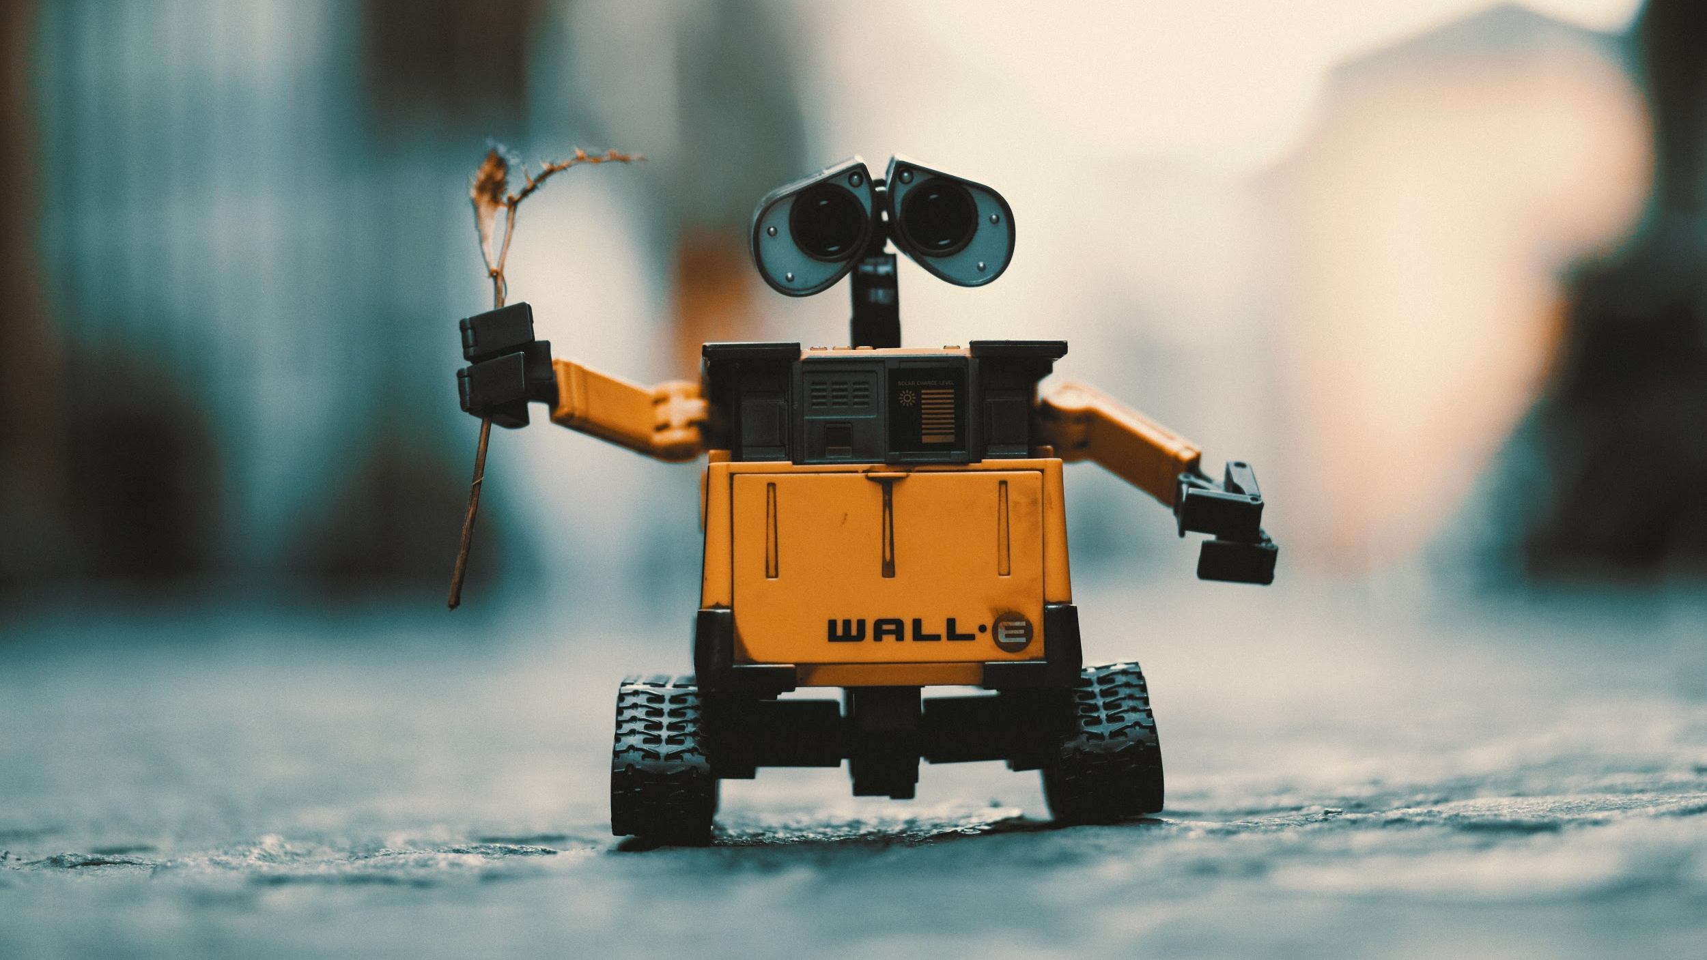
Artificial Intelligence in the Finance Industry
Notes:
http://fortune.com/2017/02/17/ai-artificial-intelligence-investment/
http://www.verdict.co.uk/say-hello-robo-bankers-ai-affecting-banking-finance/
http://www.investmentexecutive.com/-/canada-s-financial-services-sector-moving-fast-on-ai
https://www.forbes.com/sites/falgunidesai/2016/06/30/the-age-of-artificial-intelligence-in-fintech/#16e4d1850281

Slide 2



Let’s define AI in the context of a task..
If a machine were to perform a task or process, would you consider the machine to possess intelligence?
AI can involve machine learning, natural language processing & knowledge representation
There are many applications of AI research in these areas
Notes:
Natural language processing
Machine learning (machines “learn” when exposed to new data)
Expert systems (software that can provide advice)

Slide 3















38% of companies already use
AI in some capacity
Notes:
Head Data Scientist at Credit Suisse quit to start their own AI firm
JP Morgan poached their Global Head of Machine Learning from Microsoft
Bank of America poached Head of Labs from Deutsche Bank
BNP Paribas hiring 75 people for AI unit
RBC opened AI lab in Edmonton

Slide 4


Current Impact
Industry Changes
Success Stories
Leading financial institutions have started hiring Chief AI Officers and investing in AI labs & incubators
AI-powered banking bots are commonplace
Intelligent personal investment products are available at scale
Starting in 2019, CFA exam will have an AI section
Estimated that companies will spend $12.5B on AI technology/software in 2017
Many companies are building custom in-house solutions
JP Morgan Chase deployed AI for document processing (300k+ hours reduced to seconds)
Hedge funds are using AI to detect acquisitions from humanly imperceptible market changes
Top three credit agencies implemented AI for risk assessments
Notes:
Leading financial institutions: PwC, JP Morgan Chase
Document processing: work that took lawyers/loan officers 360,000 hours now completed in seconds
2017 AI spend

Slide 5


What does this mean for our future esp in Finance?

Slide 6


Finance Jobs & Functions
Potential for AI Growth
Potential for Human Growth
Intercompany reconciliations
Quarterly close & earnings reporting
Financial analysis & reporting
Accounting & auditing
Investment advisors
Trading
Compliance & fraud detection
Business strategy & planning
Financial engineering
Financial data science
Financial operations & analytics
Fintech
Notes:
Leading financial institutions: PwC, JP Morgan Chase
Document processing: work that took lawyers/loan officers 360,000 hours now completed in seconds

Slide 7
Future Impact
Bull-and-bear cycles that govern our economic theory & policy could become extinct
Embracing AI could wipe out an entire generation of entry-level finance jobs (30% in 5 years)
Intelligence Augmentation (IA) will be the new norm as we merge AI with human insight
Notes:
Leading financial institutions: PwC, JP Morgan Chase
Document processing: work that took lawyers/loan officers 360,000 hours now completed in seconds

Slide 8
Potential Benefits of End-to-End Automation
From….
To….
Client
Onboarding
175 handoffs, 20+ teams
10 steps, 2-3 teams
One size fits all coverage
Low-touch sales for e-only clients
Sales
1000s of EUDAS, >15% admin time
<5% admin time through flexible tool
Trading
High re-work rates, 260x cost for exceptions
Zero exception tolerance, first-time right capture
Trade Capture
Siloed, cross-asset
At-scale, integrated utility
Clearing
Operations
Settlements/Recs
Siloed, highly manual exception management
Cross-bank automated utility
Servicing
High-touch, costly service teams for basic activities
App-based, electronic self-servicing
Trade Risk Management
>T+3 RWA calculations
Near-real time RWA calculations
P&L
>10k manual adjustments
Real-time P&L
Reporting
Dozens of reporting tools; manual recs
Single,integrated F2B reporting
Risk, Reporting & Compliance
Manual reporting, collateral calculations
Single integrated reporting & calculation engine x-asset
Cols/Vals
Sample-based monitoring & controls
Alert-based controls & intelligent routing
Control & Compliance
Source: McKinsey Analysis
Notes:
http://news.efinancialcareers.com/ca-en/255435/the-mckinsey-co-guide-to-staying-employed-in-banking/

Slide 9

DISCUSSION

Slide 10
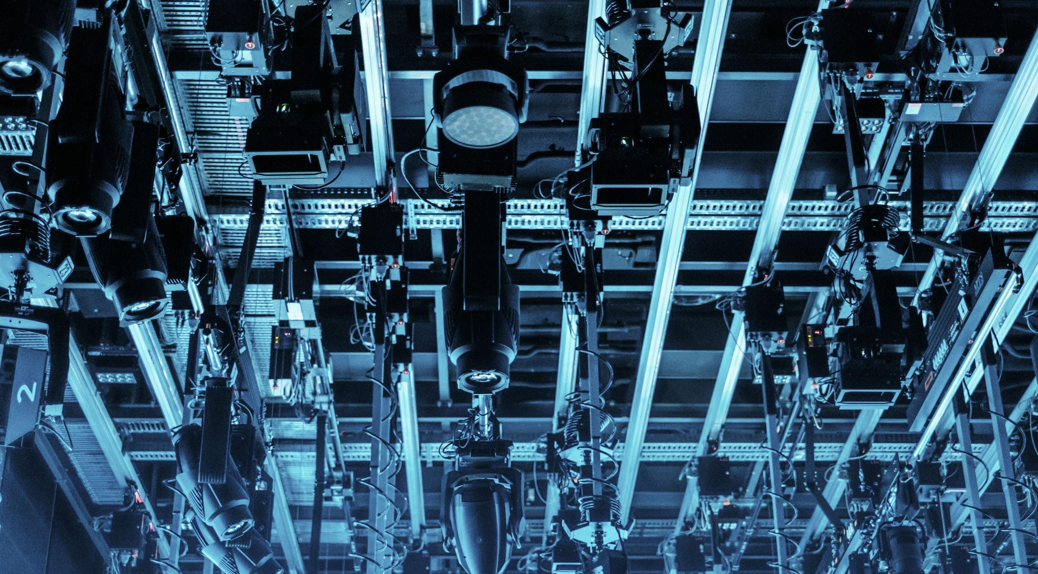
WHAT IS AI?

Slide 11

USE CASES
FOR AI

Slide 12

DATA

Slide 13

RISKS

Slide 14
WHAT’S NEXT?

Slide 15
APPENDIX | Sources
https://www.forbes.com/sites/mariyayao/2017/04/19/chatbots-go-cha-ching-the-impact-of-ai-in-finance/#3a63b5d820e3
Notes:
Natural language processing
Machine learning (machines “learn” when exposed to new data)
Expert systems (software that can provide advice)

